Slide 1
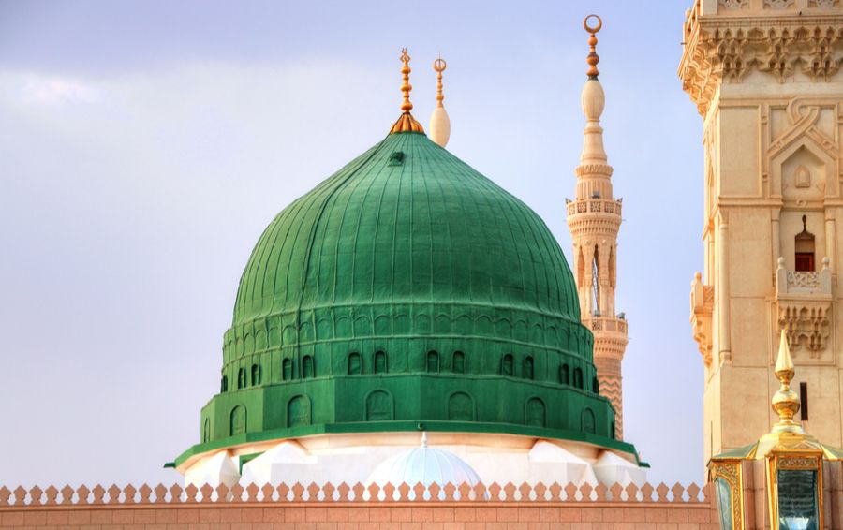
The Blessed Madina
Presented By: Muhammad Mufeez

Slide 2
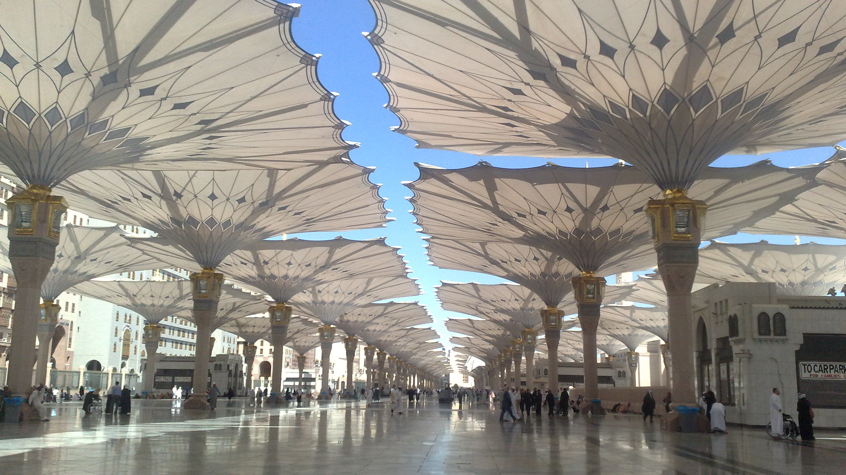
Geographical Importance
Location
Mountains
Climate
Medina is located in the western region of Saudi Arabia, in the Hejaz region. It is situated inland, away from the Red Sea coast, and is approximately 320 kilometers (200 miles) north of Mecca
The city is surrounded by several mountain ranges, including the Hijaz Mountains to the west. These mountains contribute to the variation in topography around the city and provide a backdrop to the landscape.
The Prophet's Mosque (Masjid al-Nabawi) is one of the most prominent landmarks in Medina. It is one of the holiest sites in Islam and is built on the site of the original mosque established by the Prophet Muhammad صَلَّى اللَّهُ عَلَيْهِ وَسَلَّمَ.

Slide 3
Activities That Can be done In Madina
Masjid e Nabawi
Masjid e Quba
Riyadh al - Jannah
Visit the Prophet's Mosque (Masjid al-Nabawi)
Offer Salutations and Prayers at the Prophet's Rawdah (Riyadh al-Jannah)
Explore Historical Sites
Visit Jannat al-Baqi Cemetery
Visit the Quba Mosque (Masjid Quba)

Slide 4

Cuisine
Kabsa
Mandi
Mutabrak
Roz Bukhari

Slide 5
Travel Budget
Total Expenses: 195,000 pkr

Slide 6
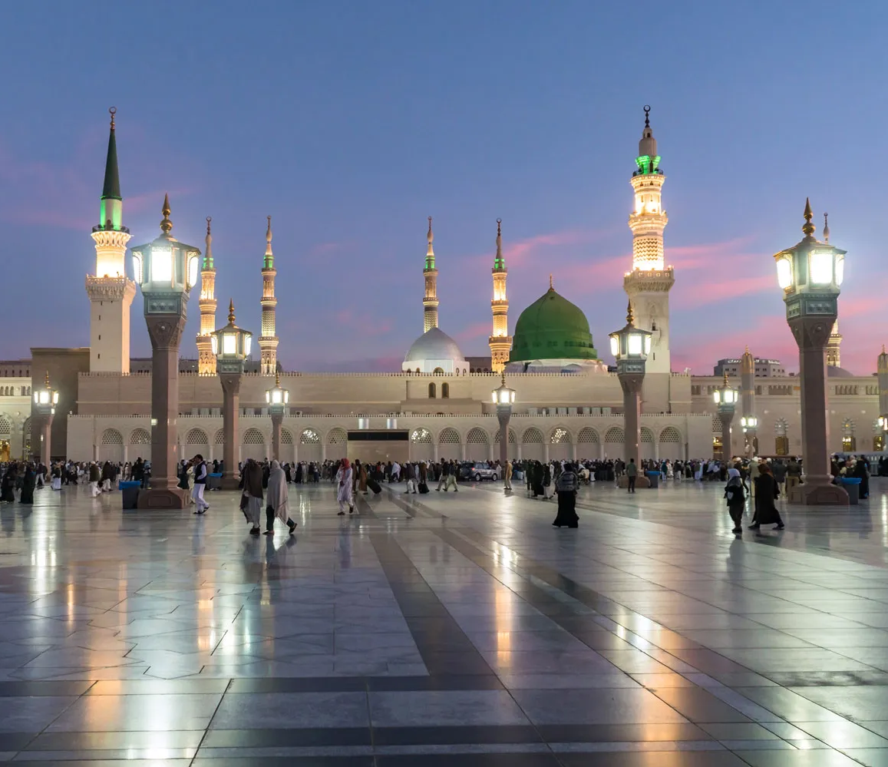
Importants Of Medina City
Medina holds immense importance to Muslims worldwide as the second holiest city in Islam, after Mecca. It is a destination of profound spiritual significance where Muslims hope to experience a deep connection with their faith and heritage. The primary reason for visiting Medina is to pay homage to the Prophet Muhammad, offer prayers at the Prophet's Mosque, and seek blessings from the sacred sites associated with his life. Pilgrims aspire to experience a profound sense of tranquility and spiritual fulfillment, strengthen their faith, and partake in the rich religious history of Islam. Medina serves as a place of reflection, prayer, and a tangible link to the Prophet's legacy, fostering a profound spiritual journey for Muslims.

Slide 7
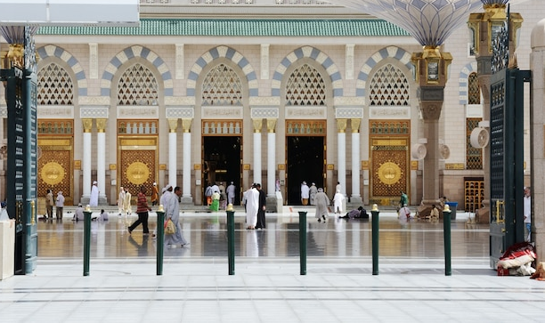
Thank You
Are you ready to make your dream vacation a reality? Let's start planning together and turn those travel dreams into unforgettable memories!

